Slide 1
Showa
Richard Moody

Slide 2

Made in USA
This Photo by Unknown Author is licensed under CC BY-SA

Slide 3
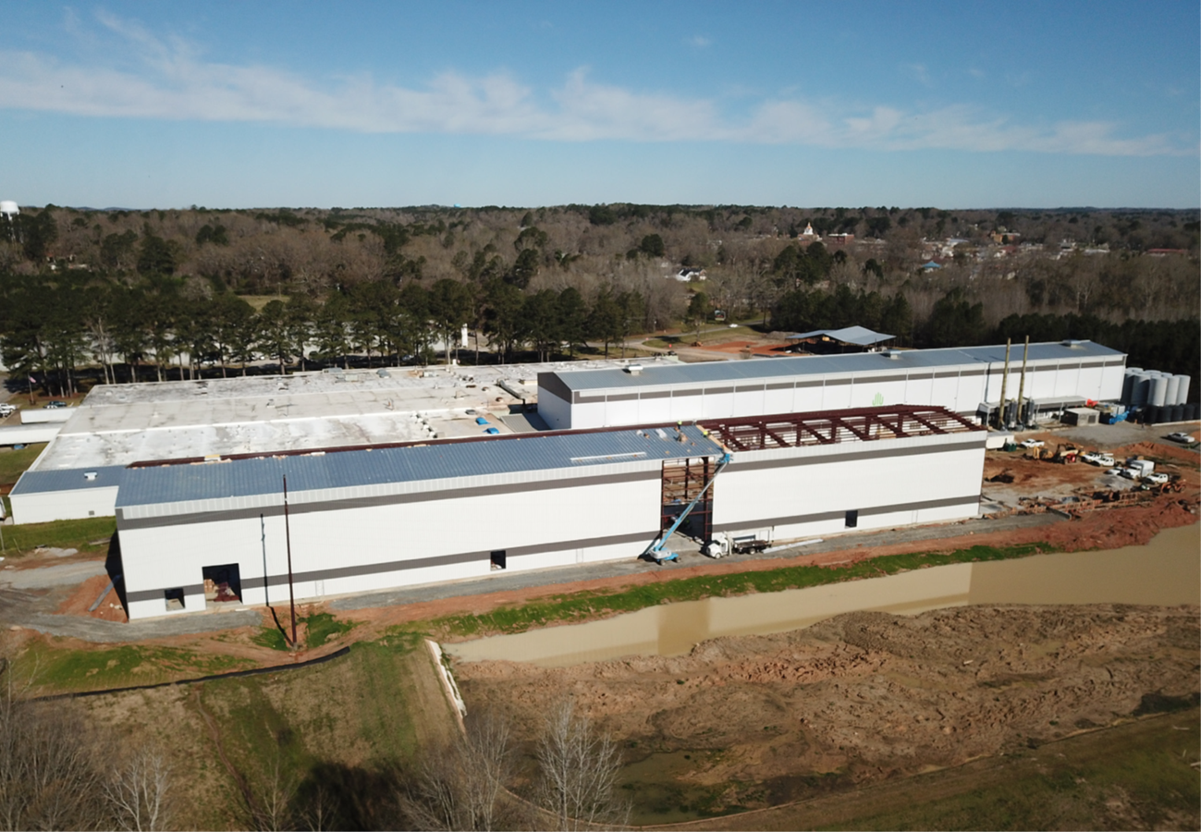

Slide 4


Slide 5
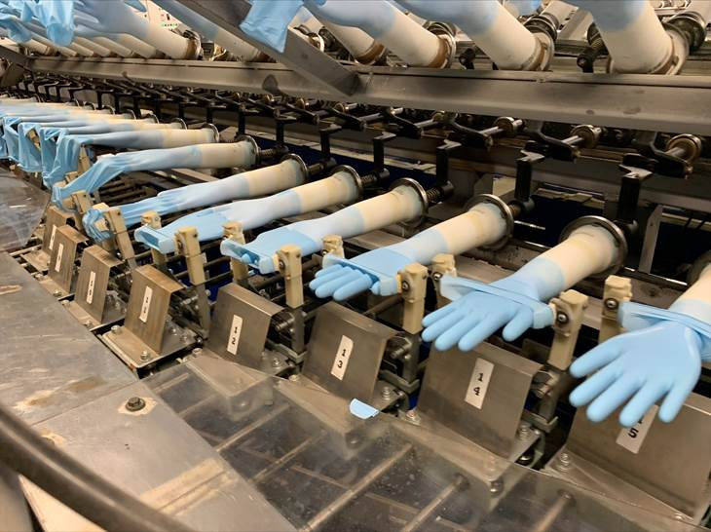

Slide 6
Sustainable Future

Slide 7
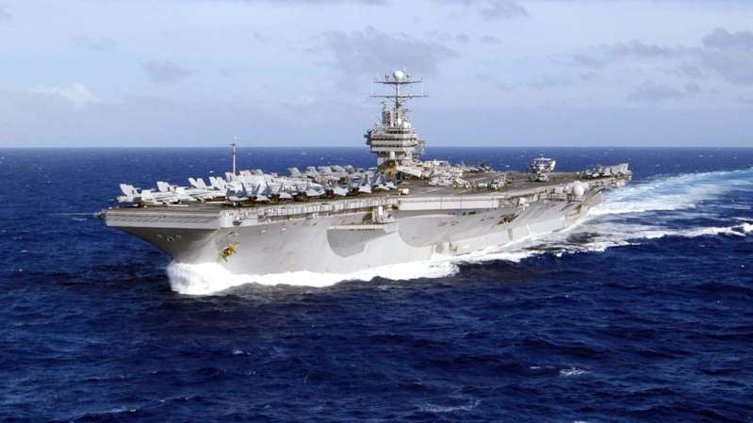

1.1 billion pounds of gloves thrown away every year = roughly the weight of 5 aircraft carriers.

Slide 8


Slide 10


Slide 11
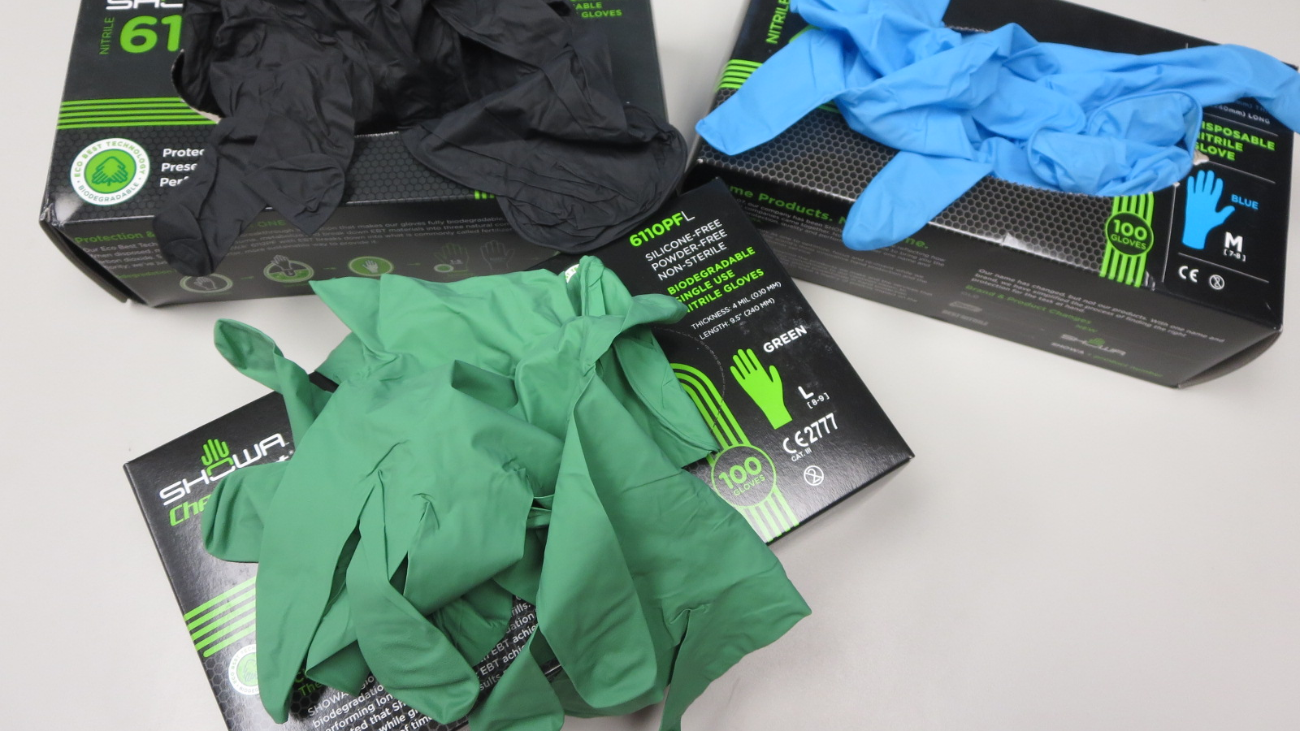

Slide 12
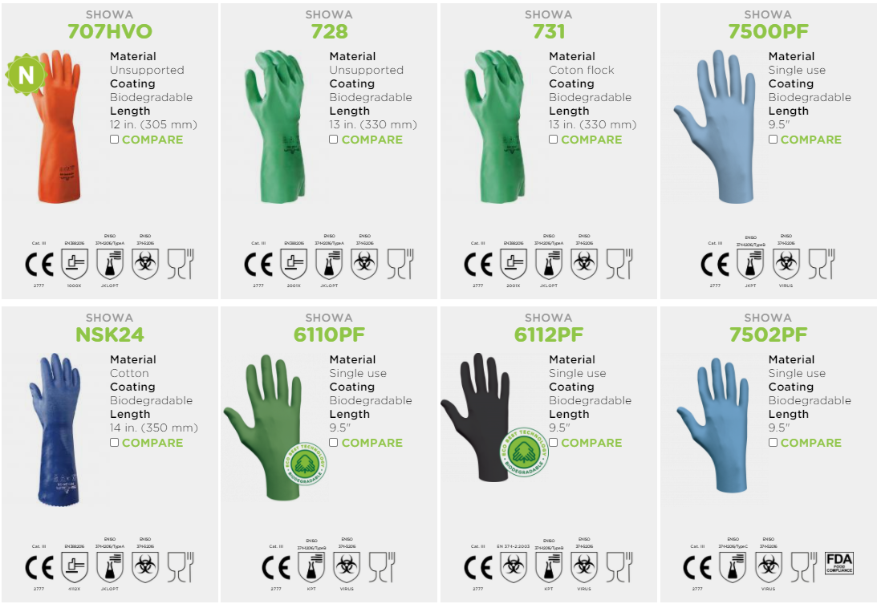

Slide 13


Slide 14
Stop by for more info and
Free Samples

